Slide 1
Design and Analysis of algorithm
Dr. Shanza Abbas
Lecture 1

Slide 2
What is Algorithm
Important Features:
Finiteness: Algorithm should end in finite amount of steps
Definiteness : each instruction should be clear
Input: valid input clearly specified
Output: single/multiple valid output
Effectiveness: steps are sufficiently simple and basic
Generality: the algorithm should be applicable to all
problems of a similar form

Slide 3
Specification of an algorithm
We can specify an algorithm by 3 types:
Using Natural language
Pseudocode
Flowchart.

Slide 4
Analysis of Algorithm: Why?
Why we are measuring the complexity of Algorithms ???.
Reason : Not only to design algorithms but to design efficient type of algorithms which can finish in finite amount of time.

Slide 5
Analysis of Algorithm
Algorithm analysis is an important part of a computational complexity theory.
Objective:
Performance analysis is the criteria for judging the algorithm.
It have direct relationship to efficiency.
When we solve a problem ,there may be more then one algorithm to solve a problem, through analysis we find the run time of an algorithms and we choose the best algorithm which takes lesser run time.

Slide 6
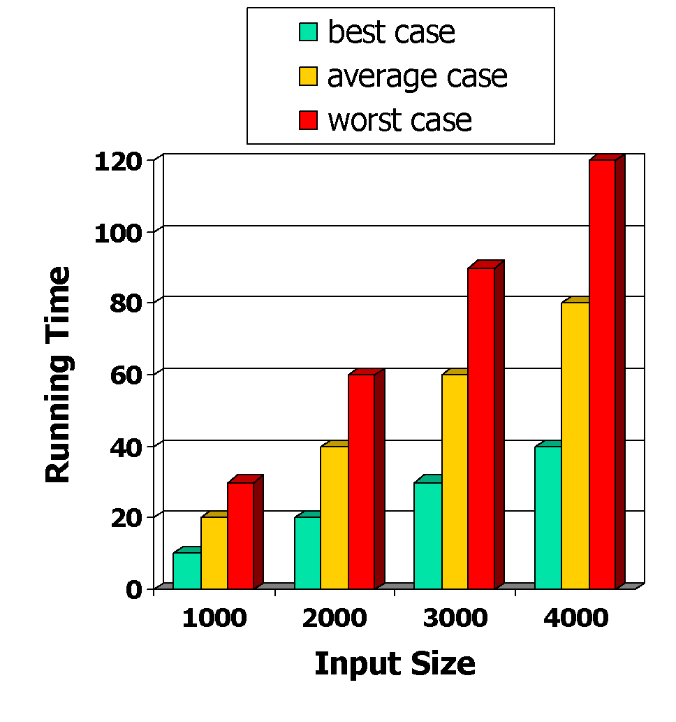
Algorithm Analysis: run time estimations
Most algorithms transform input objects into output objects.
The running time of an algorithm typically grows with the input size.
We focus on the worst case running time.
Easier to analyze
Crucial to applications such as games, finance and robotics

Slide 7
Analysis of Algorithm
There two types of analysis:
1.Posteriori
posterior Analysis is done after implement the algorithm on a target machine. In a posteriori analysis, we analyze actual statistics about the algorithms consumption of time and space, while it is executing.
2.Priori
Priori Analysis is the theoretical estimation of resources required.

Slide 8
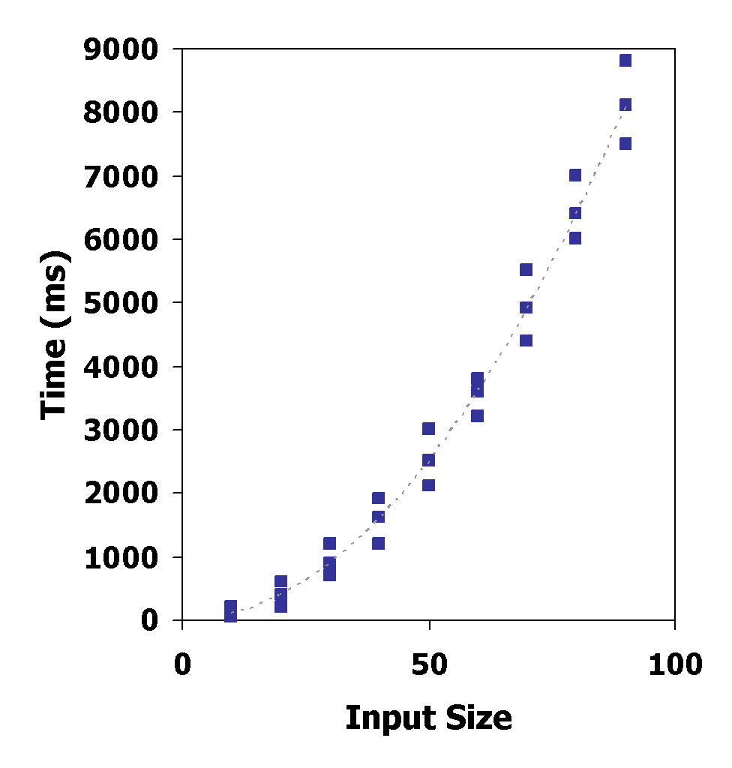
Posteriori: Experimental Studies
Write a program implementing the algorithm
Run the program with inputs of varying size and composition
Use a method like (tic; toc; in Matlab) to get an accurate measure of the actual running time
Plot the results

Slide 9
Limitations of Experiments
It is necessary to implement the algorithm, which may be difficult
Results may not be indicative of the running time on other inputs not included in the experiment.
In order to compare two algorithms, the same hardware and software environments must be used

Slide 10
Priori: Theoretical Analysis
Uses a high-level description of the algorithm (Pseudo code) instead of an implementation
Characterizes running time as a function of the input size, n.
Takes into account all possible inputs
Allows us to evaluate the speed of an algorithm independent of the hardware/software environment

Slide 11
Determination of Complexity
Sequence of statements
If-then else statements
For loops
Nested loops
Function call
Do while

Slide 12
Theoretical analysis: A simple Comparison Example
for(i=0 ; i<m ; i++)
{ m
for(j=0 ; j<n ; j++)
{ m*n
for(k=0 ; k<q ; k++)
{ }m*n*q=n^3
}
}
for(i=0 ; i<m ; i++)
{…} m
for(j=0 ; j<n ; j++)
{…} n
for(k=0 ; k<q ; k++)
{…} q
}

Slide 13
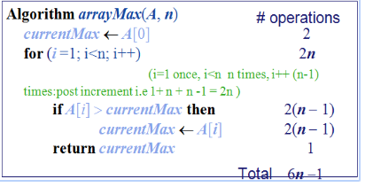
Counting Primitive Operations
By inspecting the pseudo code, we can determine the maximum number of primitive/basic operations executed by an algorithm, as a function of the input size

Slide 14
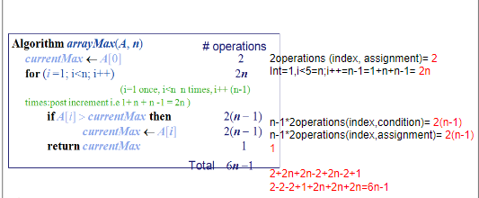
Counting Primitive Operations

Slide 15
Estimating Running Time
Algorithm arrayMax executes 6n − 1 primitive operations in the worst case.
Define:
a = Time taken by the fastest primitive operation
b = Time taken by the slowest primitive operation
Let T(n) be worst-case time of arrayMax. Then a (6n − 1) ≤ T(n) ≤ b(6n − 1 )
Hence, the running time T(n) is bounded by two linear functions

Slide 16
Input Size
Input size (number of elements in the input)
Size of an array
Polynomial degree
# of elements in a matrix
# of bits in the binary representation of the input
Vertices and edges in a graph

Slide 17
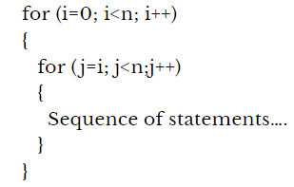
Task 1
*Assume that there is one return statement in the inner most loop.

Slide 18
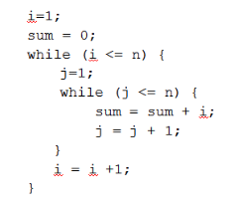
Task 2

Slide 19
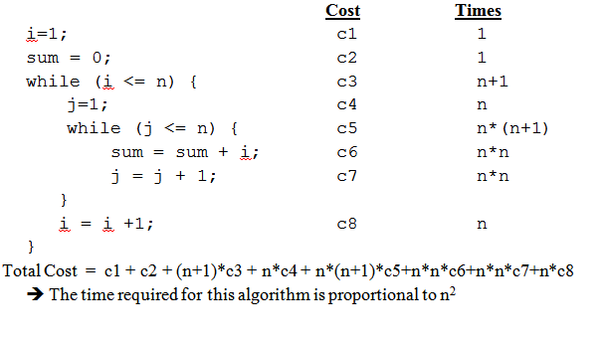
Task Continues

Slide 20
Growth Rate of Running Time
Changing the hardware/ software environment
Affects T(n) by a constant factor, but
Does not alter the growth rate of T(n)
For Example: growth rate of the running time T(n) of algorithm arrayMax is linear

Slide 21
Rate of growth
Consider the example of buying elephants and goldfish:
Cost: cost_of_elephants + cost_of_goldfish
Cost ~ cost_of_elephants (approximation)
The low order terms in a function are relatively insignificant for large n
n⁴ + 100n² + 10n + 50 ~ n⁴
i.e., we say that n⁴ + 100n² + 10n + 50 and n⁴ have the same rate of growth

Slide 22
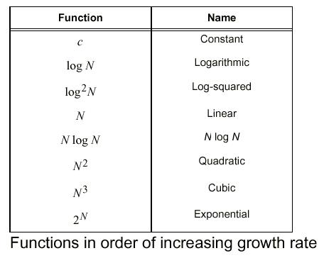
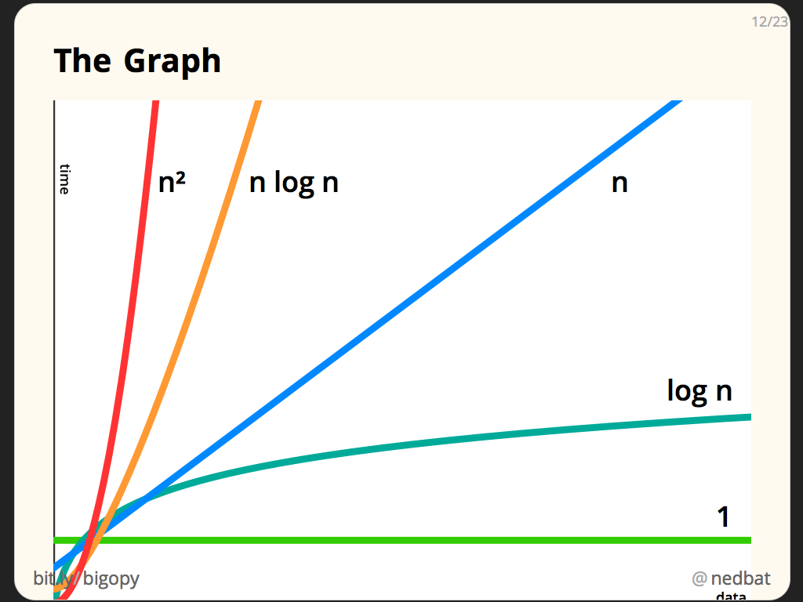
Function of Growth Rate
a growth function of the input size n (i.e., f(n)).

Slide 23
Function of Growth Rate

Slide 24
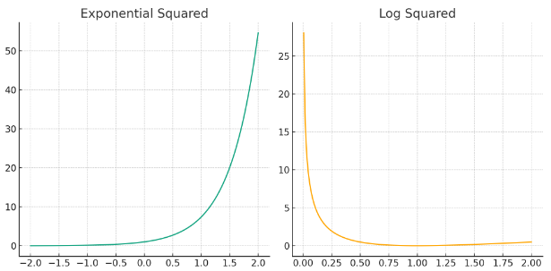
Function of Growth Rate

Slide 25

Types of Analysis
Worst case (at most)
Provides an upper bound on running time
An absolute guarantee that the algorithm would not run longer, no matter what the inputs are
Best case (at least)
Provides a lower bound on running time
Input is the one for which the algorithm runs the fastest
Average case (Average)
Provides a prediction about the running time
Assumes that the input is random

Slide 26
How do we compare algorithms?
Asymptotic Analysis
To compare two algorithms with running times f(n) and g(n), we need a rough measure that characterizes how fast each function grows.
Hint: use rate of growth
Compare functions in the limit, that are asymptotic!
(i.e., for large values of n)

Slide 27
Big-Oh Notation
To simplify the running time estimation, for a function f(n), we ignore the constants and lower order terms.
Example: 10n³+4n²-4n+5 is O(n³).

Slide 28
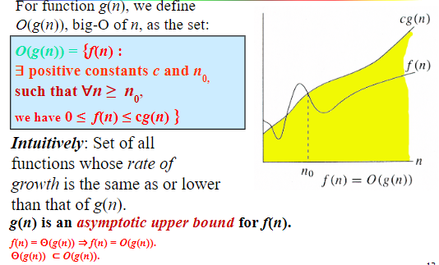
O-notation

Slide 29
O-notation
O notation :Big-O is the formal method of expressing the upper bound of an algorithm's running time.
It's a measure of the longest amount of time it could possibly take for the algorithm to complete.
Formally, for non-negative functions, f(n) and g(n), if there exists an integer n₀ and a constant c > 0 such that for all integers n > n₀, f(n) ≤ cg(n), then f(n) is Big O of

Slide 30
Rate of growth
Consider the example of buying elephants and goldfish:
Cost: cost_of_elephants + cost_of_goldfish
Cost ~ cost_of_elephants (approximation)
The low order terms in a function are relatively insignificant for large n
n⁴ + 100n² + 10n + 50 ~ n⁴
i.e., we say that n⁴ + 100n² + 10n + 50 and n⁴ have the same rate of growth

Slide 31
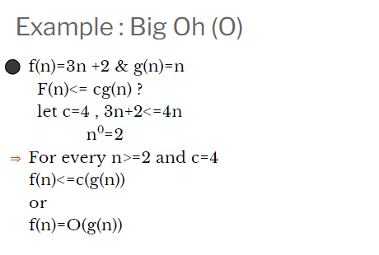

Slide 32
If (3n+2)=O(n)
=> (3n+2)=O (n²)
=> (3n+2)=O (n³)
=> (3n+2)=O (n⁴) so on…
But we always go for the least upper bound or tighter upper bound

Slide 33
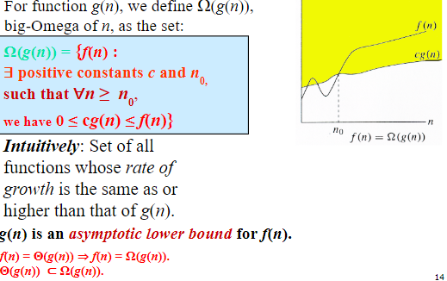
Ω -notation

Slide 34
Big-Omega Notation Ω
This is almost the same definition as Big Oh, except that "f(n) ≥ cg(n)”
This makes g(n) a lower bound function, instead of an upper bound function.
It describes the best that can happen for a given data size.
For non-negative functions, f(n) and g(n), if there exists an integer n₀ and a constant c > 0 such that for all integers n > n₀, f(n) ≥ cg(n), then f(n) is omega of g(n). This is denoted as "f(n) = Ω(g(n))".

Slide 35
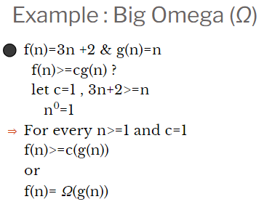

Slide 36
=> (3n+2)=Ω (n²) ?????
No
=> f(n)= Ω (n)
if f(n) is lower bounded by ‘n’ then it can be lower bounded by any g(n) which is lower bound for ‘n’
i-e (3n+2)=Ω (logn)
(3n+2)=Ω (log (log (n)))
But we always go for the closest lower bound or tighter lower bound

Slide 37
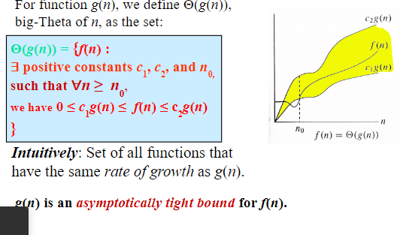
Θ-notation

Slide 38
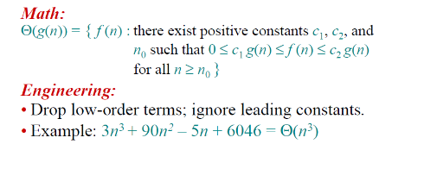
Theta Notation Θ

Slide 39
Theta Notation Θ
Theta Notation For non-negative functions, f(n) and g(n), f(n) is theta of g(n) if and only if f(n) = O(g(n)) and f(n) = Ω(g(n)). This is denoted as "f(n) = Θ(g(n))".
This is basically saying that the function, f(n) is bounded both from the top and bottom by the same function, g(n).

Slide 40
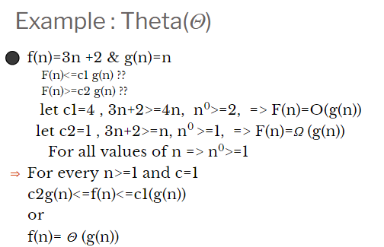

Slide 41
3n+2=Θ(n)
3n²+2n+1=Θ(n²)
6n³+n²=Θ(n³)

Slide 42
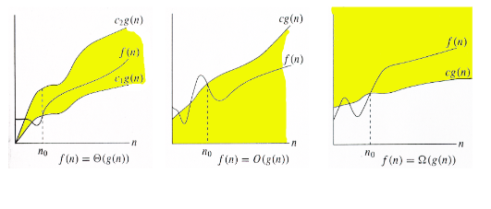
Relations Between Θ, O, Ω

Slide 43
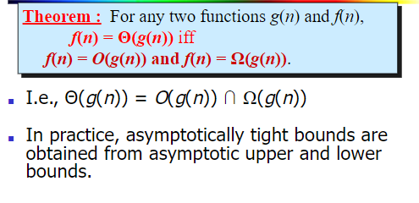
Relations Between Θ, Ω, O

Slide 44
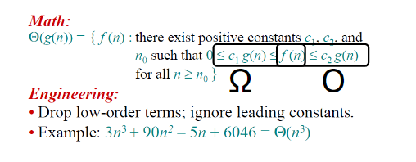

Slide 45
Asymptotic Summary
O notation: asymptotic “less than”:
f(n)=O(g(n)) implies: f(n) “≤” g(n)
Ω notation: asymptotic “greater than”:
f(n)= Ω (g(n)) implies: f(n) “≥” g(n)
Θ notation: asymptotic “equality”:
f(n)= Θ (g(n)) implies: f(n) “=” g(n)

Slide 46
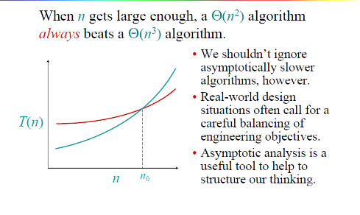
Asymptotic Performance

Slide 47
Examples of algorithms
Here is a list of common asymptotic running times:
Θ(1): Constant time; can’t beat it!
Θ(log n): Inserting into a balanced binary tree; time to ﬁnd an item in a sorted array of length n using binary search.
Θ(n): About the fastest that an algorithm can run.
Θ(n log n): Best sorting algorithms.
Θ(n²), Θ(n³): Polynomial time. These running times are acceptable when the exponent of n issmall or n is not to large, e.g., n ≤ 1000.
Θ(2^{n}), Θ(3^{n}): Exponential time. Acceptable only if n is small, e.g., n ≤ 50.
Θ(n!) : Acceptable only for really small n, e.g. n ≤ 20.

Slide 48
Best worst and average time complexity
Best case: The algorithm take as min time as it can.
Searching item in array
Found first item as key
Worst case: The algorithm take max time as it can
Searching item in array
Found the last item/ did not found item
Average case: The algorithm takes average time
Found in middle of array (Just example)

Slide 49
What is the relationship between Big O, Θ, Ω and best, worst, and average case of an algorithm?
The Ο and Ω notations do only describe the bounds of a function that describes the asymptotic behavior of the actual behavior of the algorithm. Here’s an example
Ω describes the lower bound:
f(n) ∈ Ω(g(n)) means the asymptotic behavior of f(n) is not less than g(n)·k for some positive k, so f(n) is always at least as much as g(n)·k.
Ο describes the upper bound:
f(n) ∈ Ο(g(n)) means the asymptotic behavior of f(n) is not more than g(n)·k for some positive k, so f(n) is always at most as much as g(n)·k.
We are usually interested in the worst case complexity

Slide 50
Best worst average vs Notations
These two can be applied on both the best case and the worst case for binary search:
best case: first element you look at is the one you are looking for
Ω(1): you need at least one lookup
Ο(1): you need at most one lookup
worst case: element is not present
Ω(log n): you need at least log n steps until you can say that the element you are looking for is not present
Ο(log n): you need at most log n steps until you can say that the element you are looking for is not present
But often we do only want to know the upper bound or tight bound as the lower bound has not much practical information.

